Slide 1
Arduino Robot Project

Slide 2
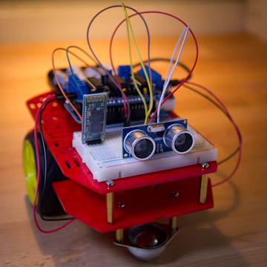
Robot Features
It should be a vehicle that can move forward, backwards and turn.
It should be easy to assemble and disassemble.
It should have a mode in which it is able to move on its own, detecting obstacles ahead and avoiding them.
It should have a mode in which it can be fully controlled from my Android smartphone.
It should be easy to hack, change and improve.

Slide 3
What we need for this project
Arduino board
Motor controller
Distance sensor
Bluetooth slave
Prototyping board and cables
USB cable
Vehicle kit

Slide 4
Componets
The Arduino board will be the brain of the robot, as it will be running the software that will control all the other parts.
The Arduino board cannot directly control a motor. The tricky part is to be able to make the motor selectively run forward or backwards, which requires swapping power and ground inputs into the motor.There is a specialized circuit called an H-Bridge that can do this, and there are several implementations of this circuit readily available for the Arduino platform, or you can also build one from basic parts for next to nothing.
Distance sensors send an ultrasonic signal forward and then wait to receive a bounced signal. Depending on how long the signal takes to bounce back the approximated distance to an obstacle can be calculated. I will use this little device to prevent the robot from hitting walls or other obstacles in its way.

Slide 5
The Bluetooth Slave , the easiest way to control the robot from a smartphone is via the bluetooth serial interface that all modern smartphones have. The phone will act as a master, so I needed a bluetooth slave for the robot.
The Prototyping Board and Cables one of the restrictions I decided to impose myself with this project is that I would not do any soldering, so that I can assemble and disassemble the robot to my heart's content without ruining any partsThen I needed a platform where I can easily connect all the components together. For this kind of task people typically use a breadboard.

Slide 6
Bill of Materials
Arduino board (Arduino Uno R3) $21.95
Motor controller (Arduino Motor Shield R3) $33.01
Distance sensor (HC-SR04) $6.59
Bluetooth slave (BT2S Bluetooth to Serial Slave) $14.95
Prototyping board and cables (microtivity IB401) $8.66
USB cable(Amazon Basics USB 2.0 A-Male to B-Male Cable, 6 feet) $5.49
Vehicle kit(Magician Chassis) $25

